Slide 1
Time Series Analysis Fundamentals of Data Analysis
Dr. Babji Srinivasan
Department of Applied Mechanics
IIT Madras

Slide 2
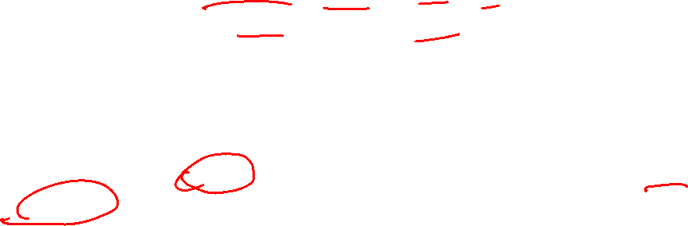
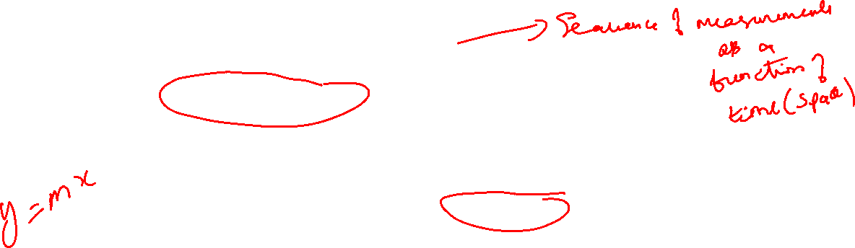
What is a time-series?
Time-series is a set of data observed (or measured) at regularly or irregularly spaced time instants
The independent dimension in general could be different from time, such as length, frequency or any other quantity
Time-series is synonymous with a set of sampled-data
Observations could be a result of measurements using a physical sensor (e.g., temperature, pressure, rainfall level) or by calculations of some indices (e.g., stock market price, student grades)
Time-series analysis
Time-series analysis consists of processing the observed data to extract meaningful and useful information. This information is used for various purposes such as forecasting (prediction), control, pattern recognition, fault detection, etc.

Slide 3
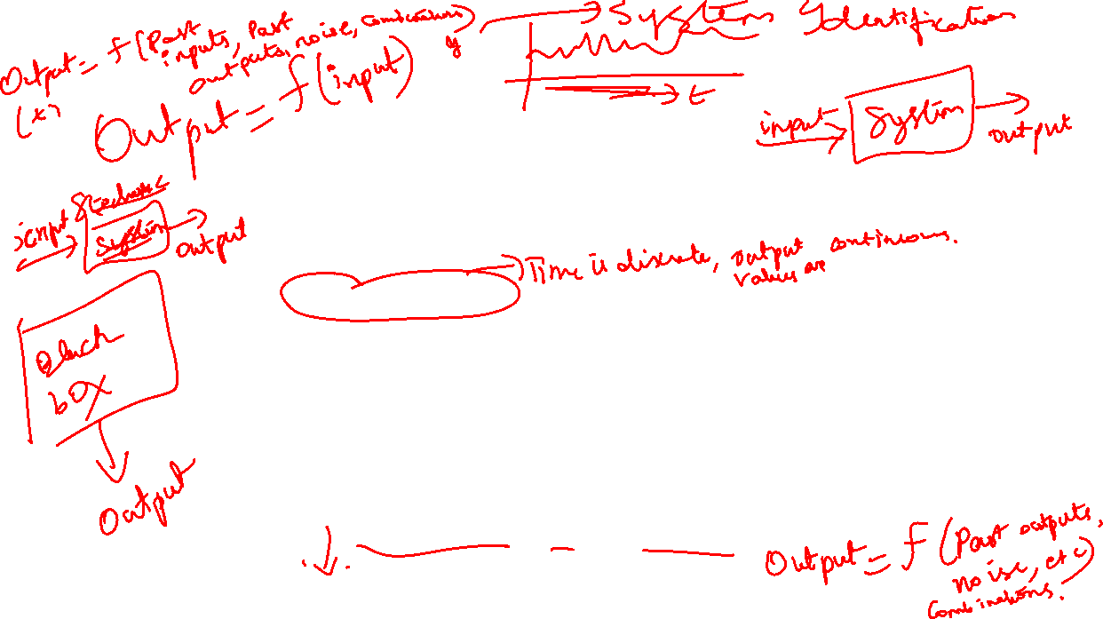
What is Time Series?
A Time series is a set of observations, each one being recorded at a specific time. (Annual GDP of a country, Sales figure, etc)
A discrete time series is one in which the set of time points at which observations are made is a discrete set. (All above including irregularly spaced data)
Continuous time series are obtained when observations are made continuously over some time intervals. It is a theoretical Concept. (Roughly, ECG graph).
A discrete valued time series is one which takes discrete values. (No of accidents, No of transaction etc.).

Slide 4
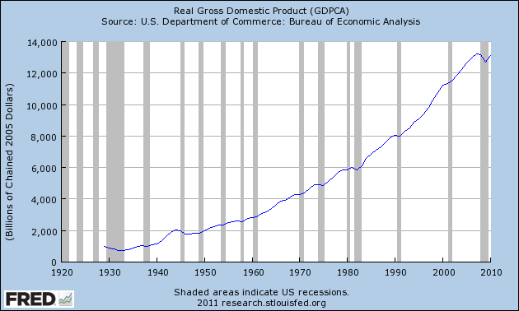

Few Time series Plots
Annual GDP of USA

Slide 5
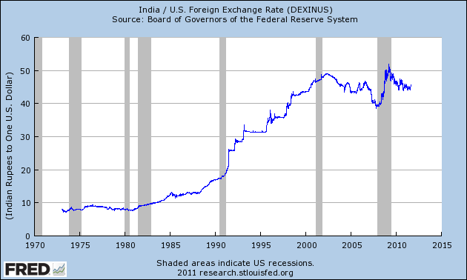
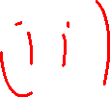

A discrete time series is one in which the setof time points at which observations are made is a discrete set. (All above including irregularly spaced data)

Slide 6
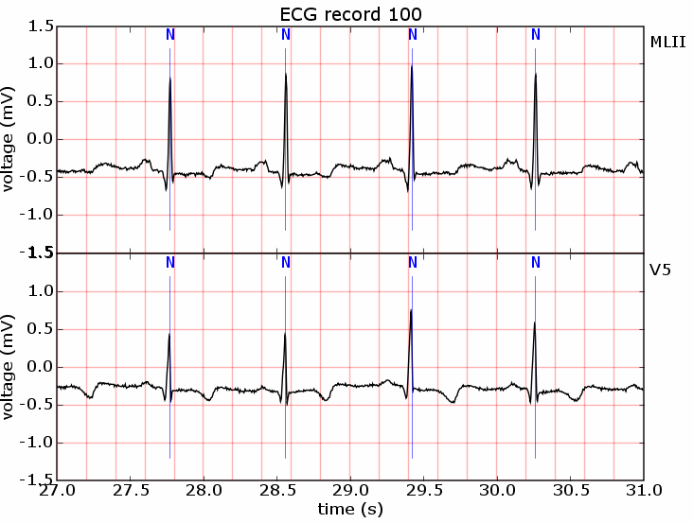
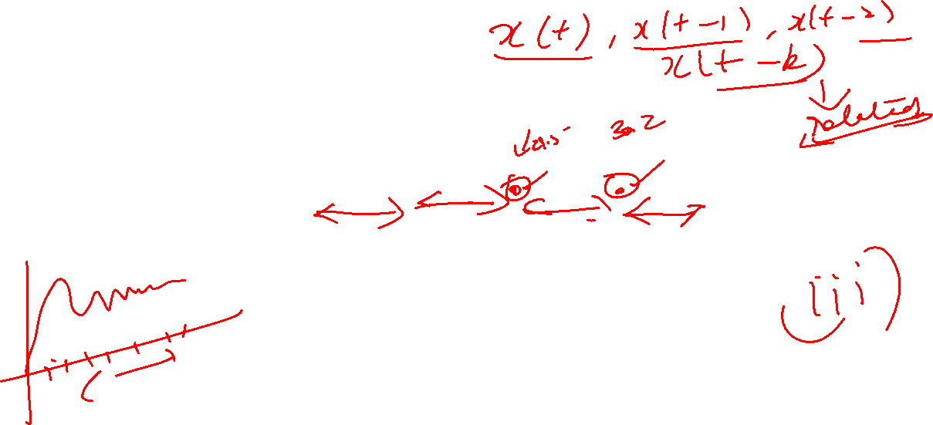
Continuous time series are obtained when observations are made continuously over some time intervals. (ECG graph).

Slide 7
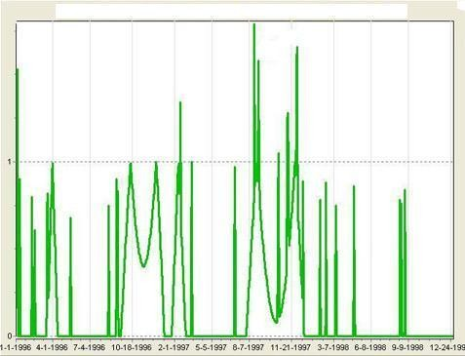
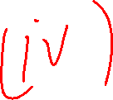

A discrete valued time series is one which takes discrete values. (No of accidents, No of transaction etc.).
Time series plot on car accident in U.K.

Slide 8
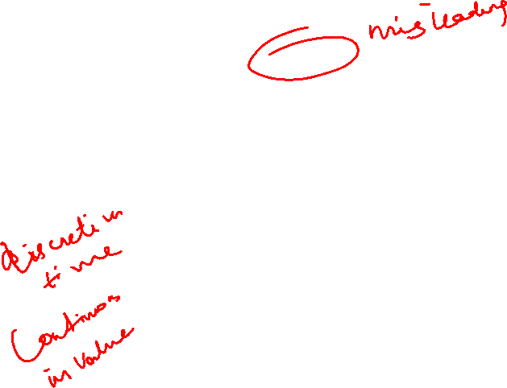
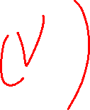
Continuous time series data (Stock returns):
Stock Returns
0.5
0.4
0.3
0.2
0.1
0
-0.1
-0.2
-0.3
-0.4
Stock Returns
1801
1808
1815
1822
1829
1836
1843
1850
1857
1864
1871
1878
1885
1892
1899
1906
1913
1920
1927
1934
1941
1948
1955
1962
1969
1976
1983
1990
1997
2004

Slide 9
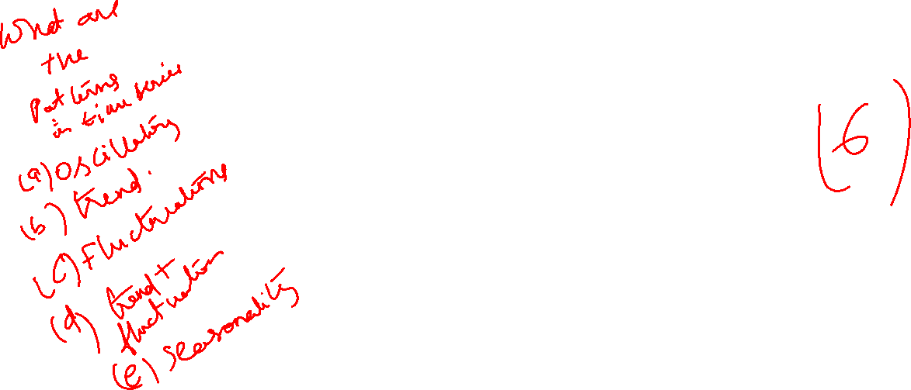
Time series data (Number of sunspots) showing cycles:
Sunspots
400
350
300
250
200
150
100
50
0
Sunspots
1/1/1950
1/1/1953
1/1/1956
1/1/1959
1/1/1962
1/1/1965
1/1/1968
1/1/1971
1/1/1974
1/1/1977
1/1/1980
1/1/1983
1/1/1986
1/1/1989
1/1/1992
1/1/1995
1/1/1998
1/1/2001
1/1/2004
1/1/2007
1/1/2010

Slide 10
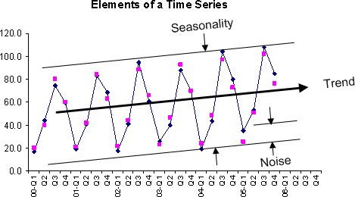
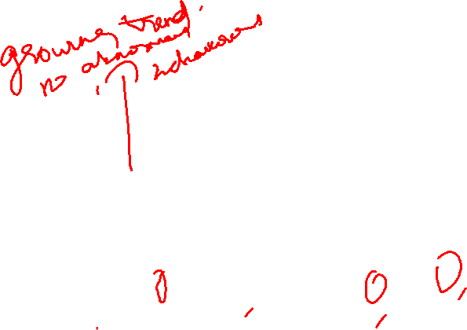
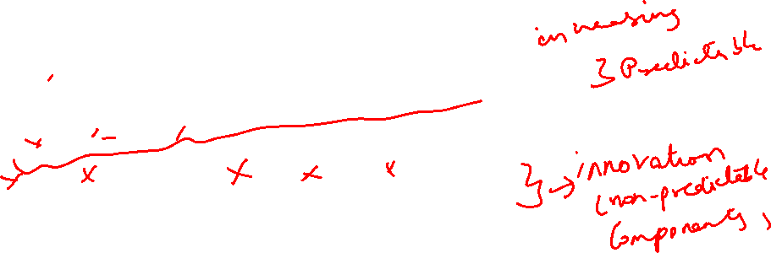
Quarterly Sales of Ice-cream
Q1-Dec-Jan

Slide 11
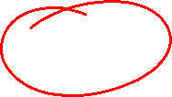
Objective of Time Series Analysis
Forecasting (Knowing future is our innate wish).
Control (whether anything is going wrong, think of ECG, production process etc)
Understanding feature of the data including seasonality, cycle, trend and its nature. Degree of seasonality in agricultural price may indicate degree of development. Trend and cycle may mislead each other (Global temperature may be an interesting case)

Slide 12
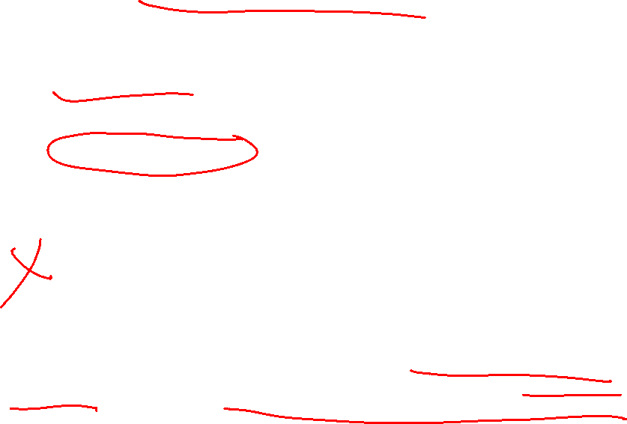
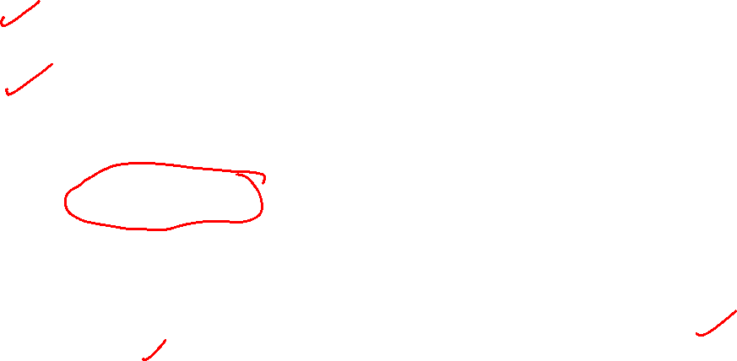
What does time-series analysis involve?
The analysis of time-series data involves one or more of the following tasks
Trend analysis: Does the observed data exhibit any particular trend such as periodicity, seasonal variation, or any other pattern?
Correlation analysis: Is there a dependence between successive observations of a quantity? Is there a relationship between the evolution of one time-series and that of another time-series?
Spectral analysis: What frequency components make up the observed data? What are their relative strengths? Do these frequency components vary with time?
Note that while correlation analysis primarily involves processing in time-domain, spectral analysis involves processing in frequency-domain.
These are two different domains that provide complementary information.

Slide 13
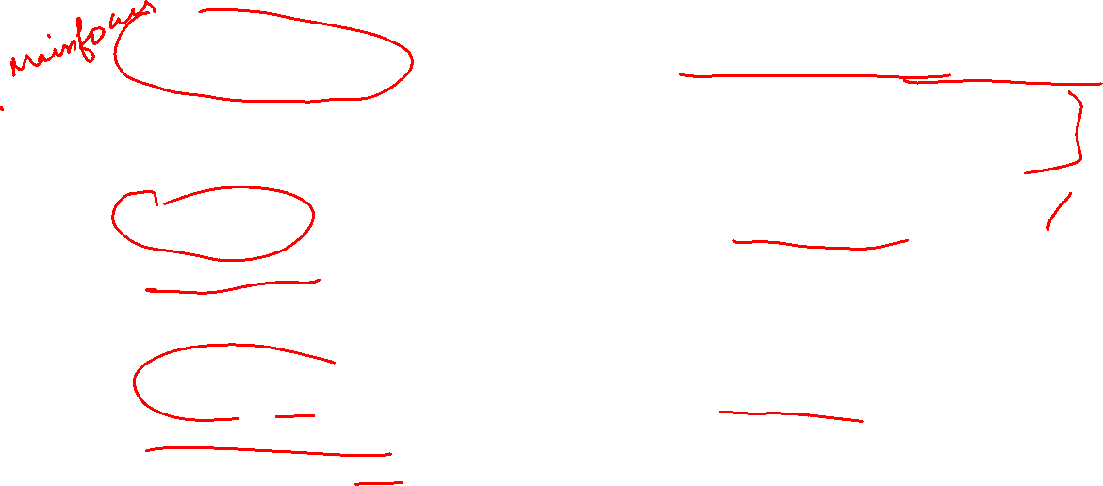
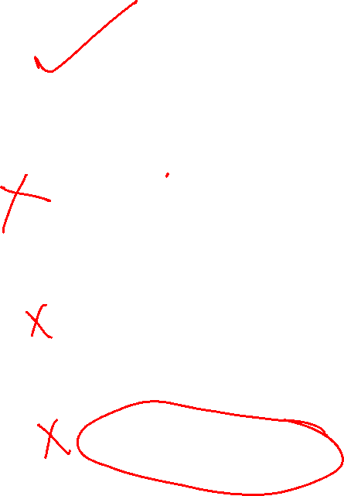
Tasks in time-series analysis
Time-series modelling: Build models to predict the behaviour of random quantities. These models assume that a class of random signals can be modelled as fictitious random inputs passing through a linear time-invariant system.
Estimation: What is the true signal underneath a measured quantity that is in general corrupted with noise? Consists of one or more of smoothing, filtering and prediction. Estimation is a very important task in data analysis.
Data pre-processing: Measured data can come with outliers and many a time with missing observations. This step is concerned with detecting these outliers and suitably replacing the missing data. This step typically consumes large hours of data analysis
Multivariate data analysis: A very important area of data analysis where measurements from a multivariate system are analyzed

Slide 14
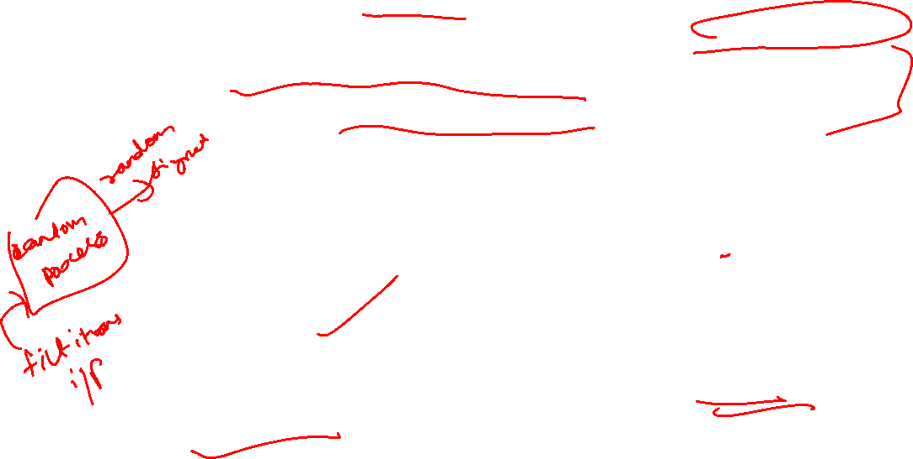
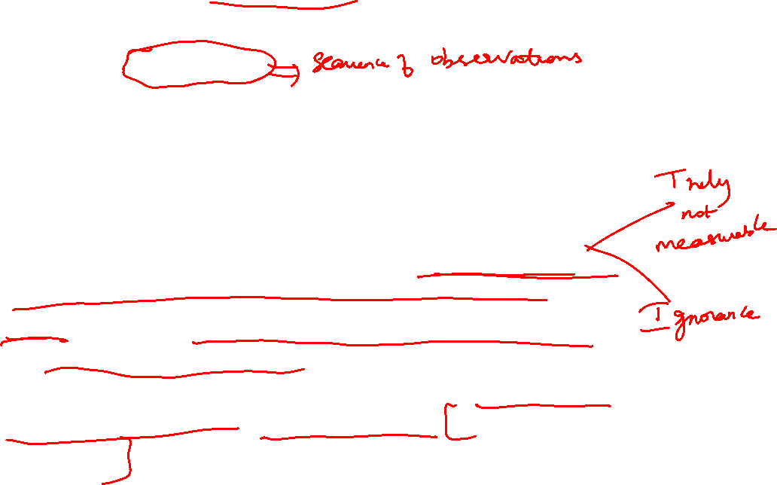
Important aspects of time-series modelling
Time-series analysis is traditionally concerned with analysis of what are known as random signals
Random signals are assumed to be generated by random processes Random process is essentially a process (or quantity) that evolves in time according to some probabilistic laws
Time-series modelling is essentially concerned with prediction of these random signals from their observations
The uniqueness of time-series modelling is that no physical input(s) can be identified as responsible for the variation in the random signals. Rather, these variations are assumed to be due to the effect of some fictitious (random) inputs.
In contrast, in modelling of engineering systems, there is always a set of input-output pair whose relationship is sought (system identification)

Slide 15
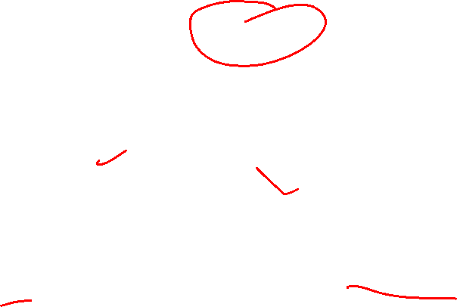
Scope of applications
Geosciences and meteorology (weather forecasting, trends in weather patterns)
Business and finance (econometrics) (stock market analysis, business forecasting)
Process control and other engineering applications (modelling of disturbance effects, uncertainties)
Biostatistics
Multivariate statistical data analysis (fault detection, pattern recognition, image analysis)
Medicine (monitoring of lab variables, epidemic analysis, clinical decisions)
Physics, astronomy and several other areas

Slide 16
Time Series patterns

Slide 17
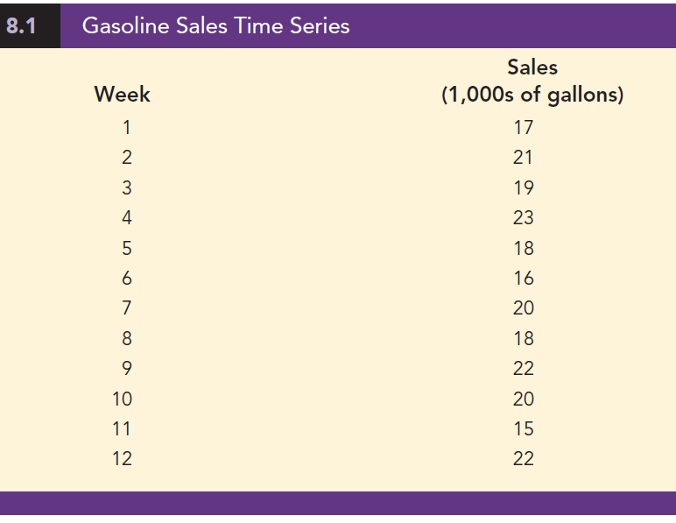
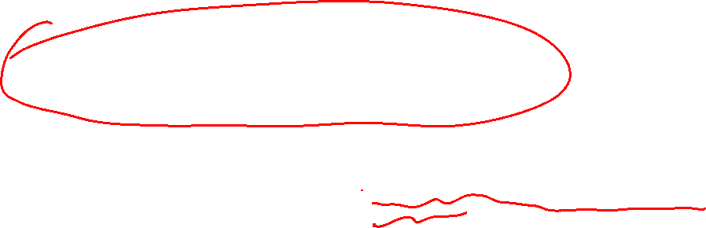
Horizontal Pattern
A horizontal pattern exists when the data fluctuate randomly around a constant mean over time.
These data show the number of gallons of gasoline (in 1,000s) sold by a gasoline distributor in Bennington, Vermont, over the past 12 weeks.
The average value, or mean, for this time series is 19.25 or 19,250 gallons per week

Slide 18
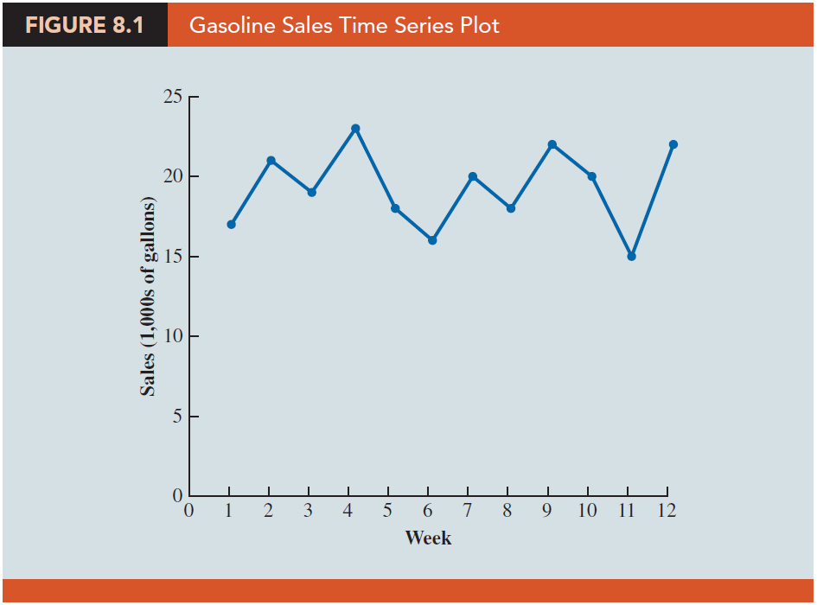
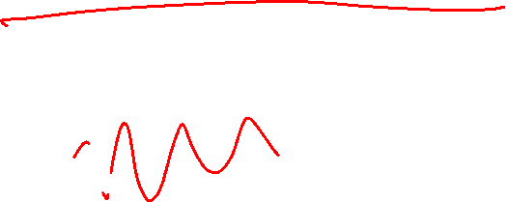
Horizontal Pattern
Note how the data fluctuate around the sample mean of 19,250 gallons.
Although random variability is present, we would say that these data follow a horizontal pattern.

Slide 19
Trend Pattern
Time series data generally exhibit random fluctuations, a time series may also show gradual shifts or movements to relatively higher or lower values over a longer period of time.
If a time series plot exhibits this type of behavior, we say that a trend pattern exists.
A trend is usually the result of long-term factors such as:
population increases or decreases
shifting demographic characteristics of the population
improving technology
changes in the competitive landscape, and/or changes in consumer preferences.

Slide 20
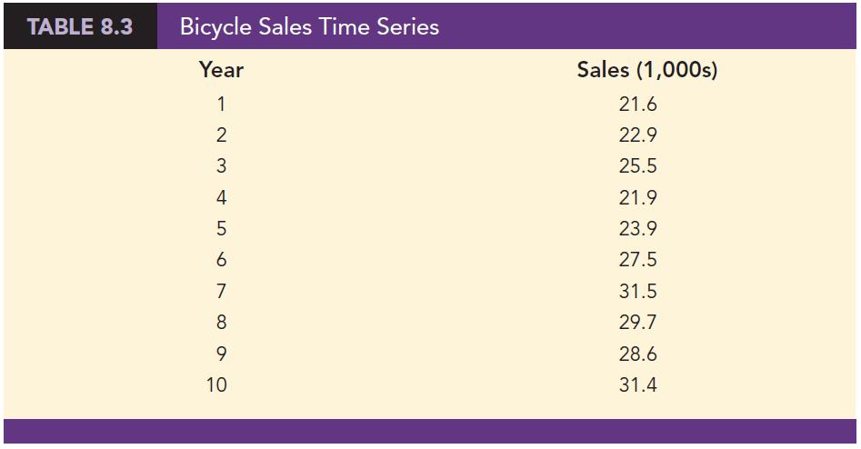
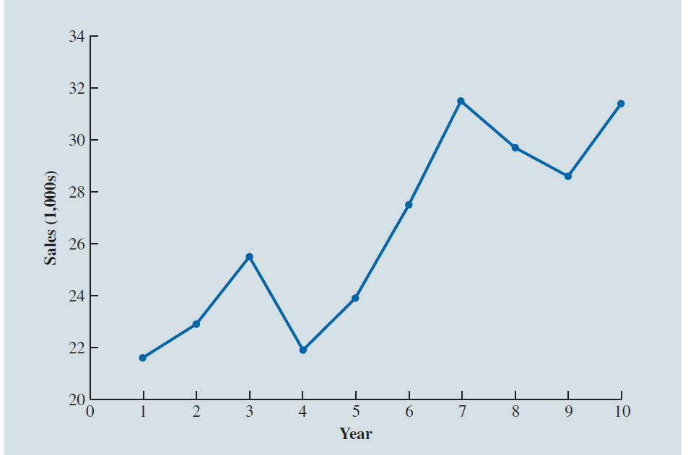
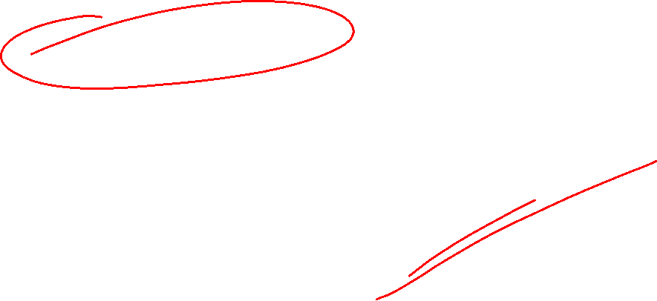

Trend Pattern

Slide 21
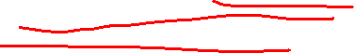

Seasonal Pattern
The trend of a time series can be identified by analyzing movements in historical data over multiple time periods.
Seasonal patterns are recognized by observing recurring patterns over successive periods of time.
For example:
a retailer who sells bathing suits expects low sales activity in the fall and winter months, with peak sales in the spring and summer months to occur every year.
Retailers who sell snow removal equipment and heavy clothing, however, expect the opposite yearly pattern.

Slide 22
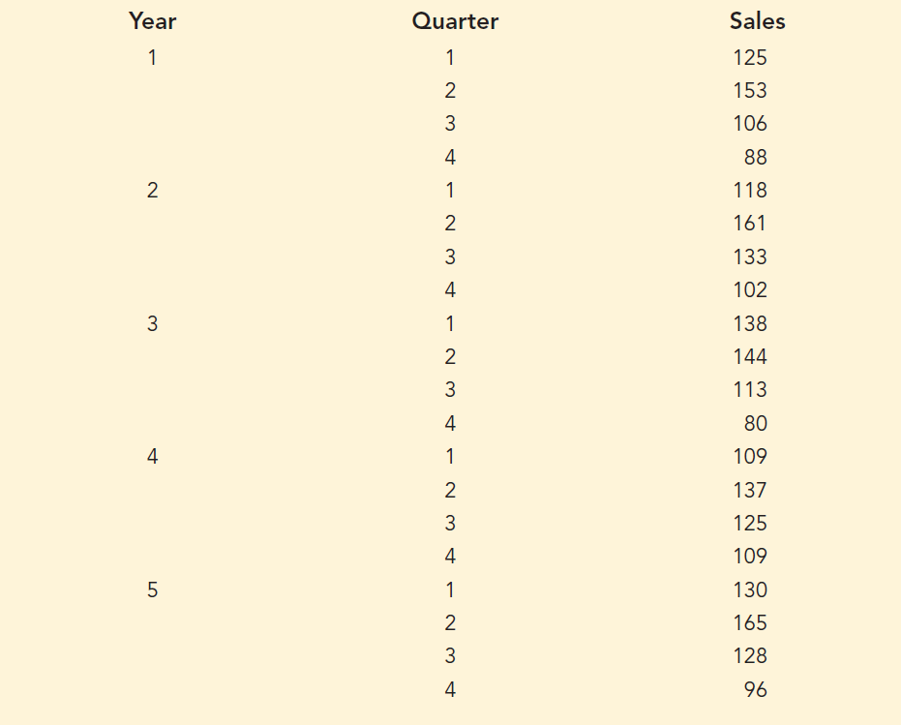
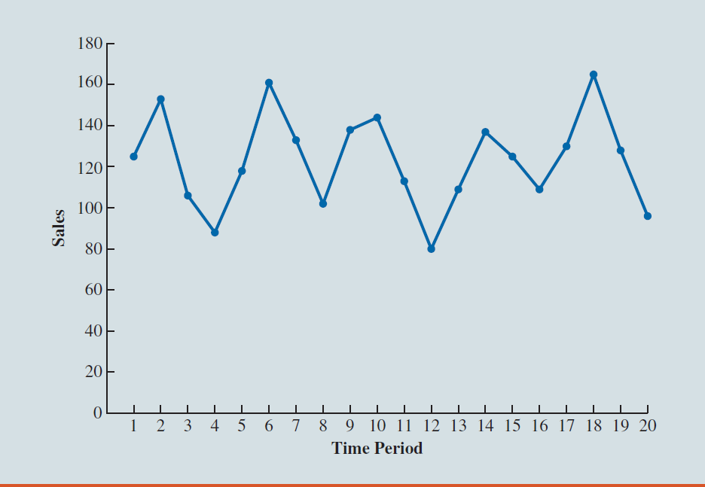

Seasonal Pattern

Slide 23
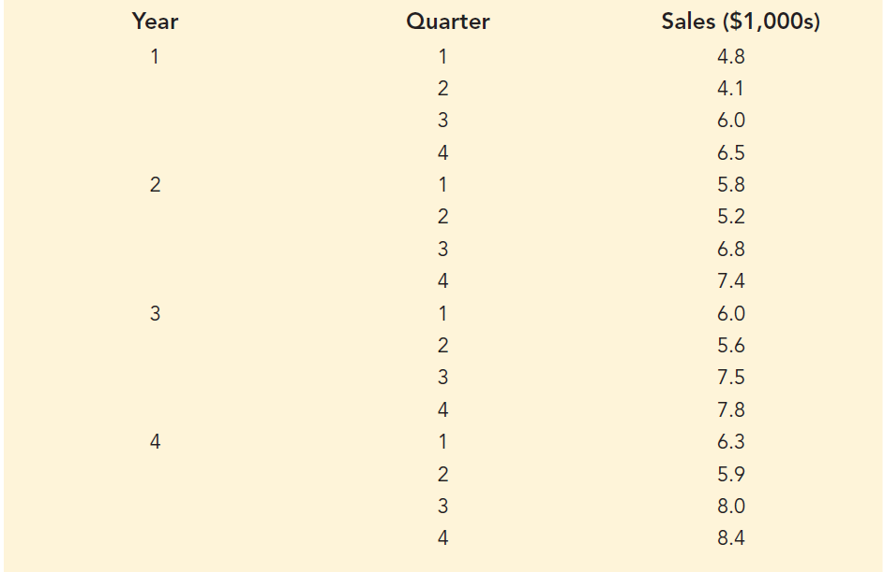
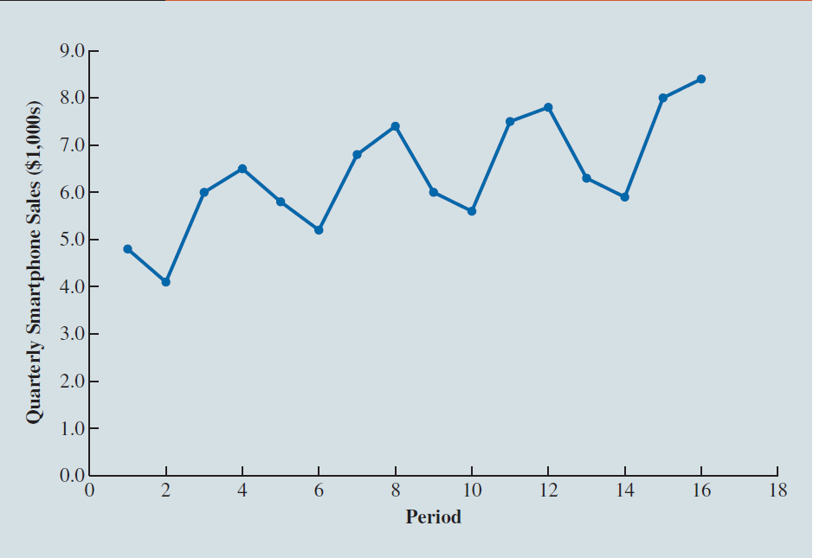
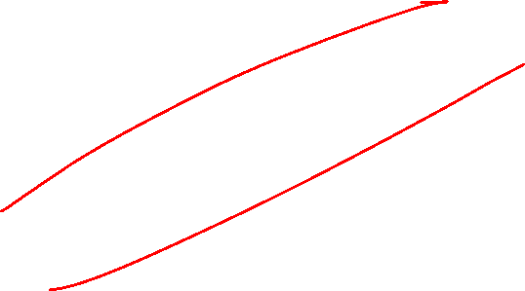
Trend and Seasonal Pattern

Slide 24
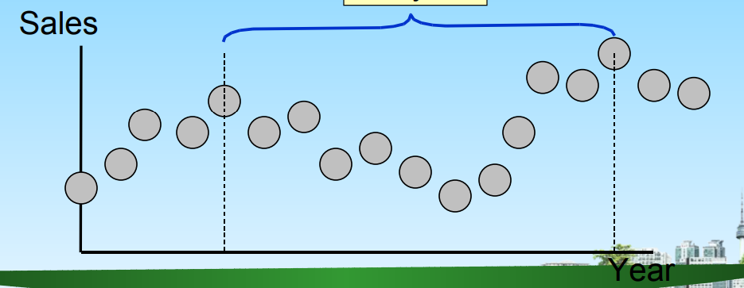
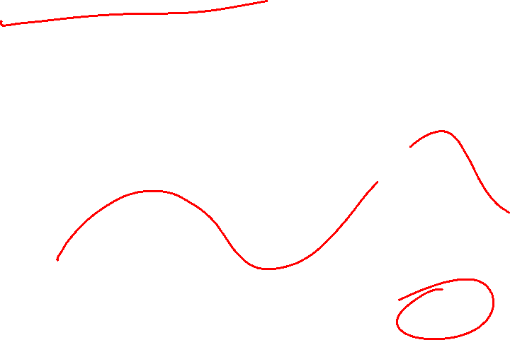
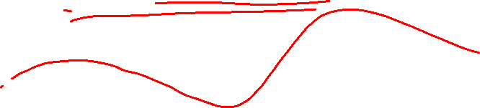
Cyclic Pattern
Long-term wave-like patterns
Regularly occur but may vary in length
Often measured peak to peak or trough to trough
One Cycle

Slide 25
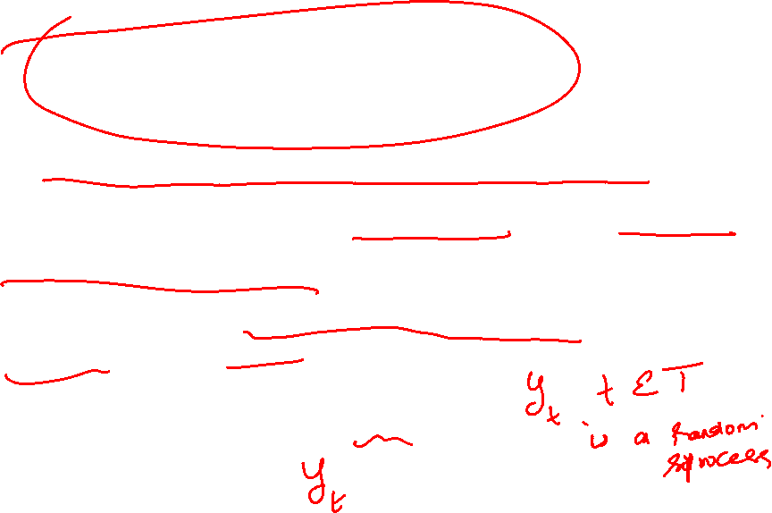
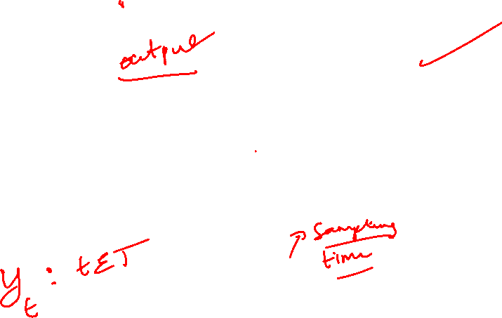
Stochastic processes Approach
Time series are an example of a stochastic or random process
A stochastic process is a statistical phenomenon that evolves in time according to probabilistic laws.
Mathematically, a stochastic process is an indexed collection of random variables
{𝑦_{𝑡}: 𝑡 ∈ 𝑇}

Slide 26
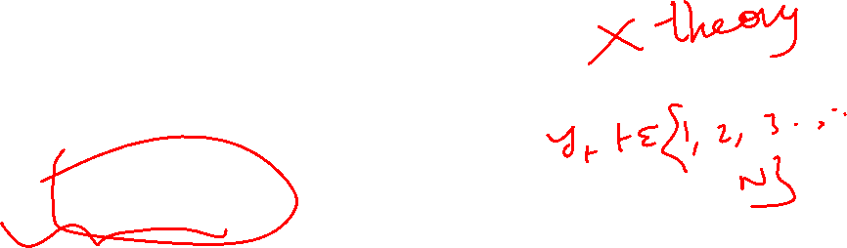
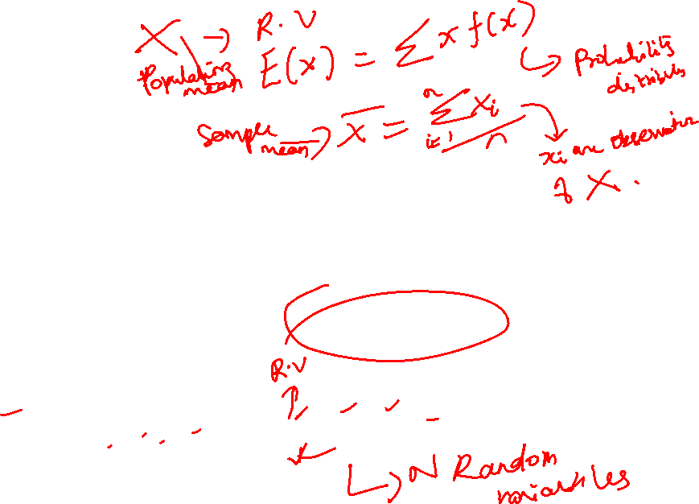
Stochastic processes
We are concerned only with processes
indexed by time, either discrete time or
continuous time processes such as
{𝑦_{𝑡}: 𝑡 ∈ (−∞, ∞)} = {𝑦_{𝑡}: −∞ < 𝑡 < ∞}
Or
{𝑦_{𝑡}: 𝑡 ∈ (1,2,3, … )} = {𝑦_{1,}𝑦_{2,}𝑦₃, … }

Slide 27
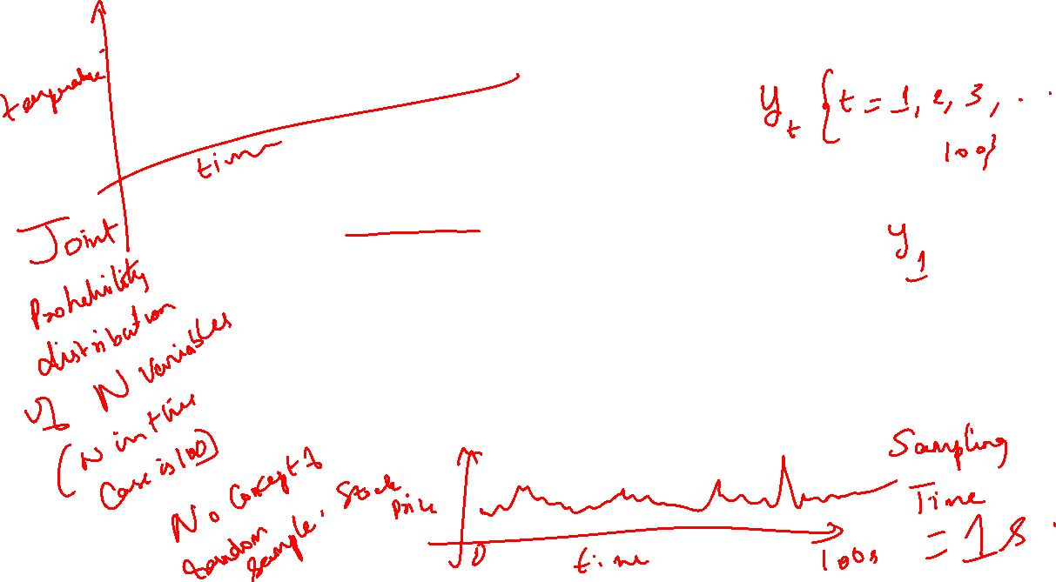
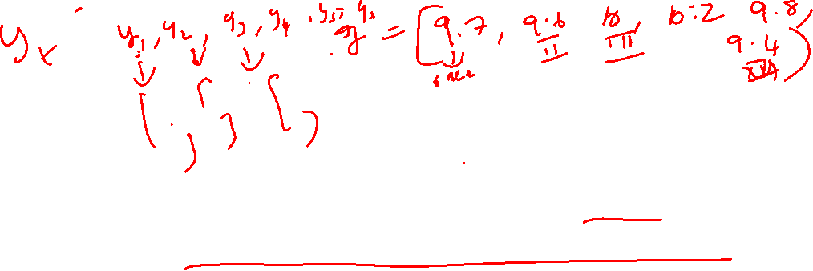
Stochastic Process
A stochastic process{𝑦_{𝑡}}∞ is a collection
𝑡=−∞
of random variables or a process that develops in time according to probabilistic laws.
The theory of stochastic processes gives us a formal way to look at time series variables.

Slide 28
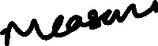
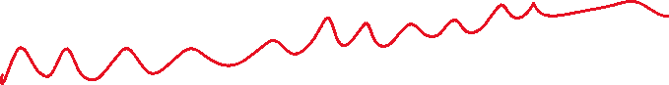
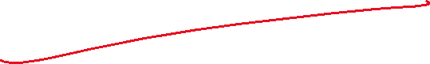
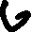
















































Slide 29

DEFINITION
𝑦(𝑤, 𝑡): 𝑠𝑡𝑜𝑐ℎ𝑎𝑠𝑡i𝑐 𝑝𝑟𝑜𝑐𝑒𝑠𝑠
Sample Space
Index Set
For a fixed t, y(w, t) is a random variable.
For a given w, y(w, t) is called a sample function or a realization as a function of 𝑡.

Slide 30


Stochastic Process
Time series is a realization or sample function from a certain stochastic process.
A time series is a set of observations generated sequentially in time. Therefore, they are dependent to each other. This means that we do NOT have random sample.
We assume that observations are equally spaced in time.
We also assume that closer observations might have stronger dependency.

Slide 31

JOINT PDF OF A TIME SERIES
Remember that
𝐹_{𝑦1} (𝑦₁): 𝑡ℎ𝑒 𝑚𝑎𝑟𝑔i𝑛𝑎𝑙 𝑐𝑑ƒ ƒ_{𝑦1} (𝑦₁): 𝑡ℎ𝑒 𝑚𝑎𝑟𝑔i𝑛𝑎𝑙 𝑝𝑑ƒ
𝐹_{𝑦1,𝑦2,…,𝑦𝑛} (𝑦₁, 𝑦₂, … , 𝑦_{𝑛}): 𝑡ℎ𝑒 j𝑜i𝑛𝑡 𝑐𝑑ƒ ƒ_{𝑦1,𝑦2,…,𝑦𝑛} (𝑦₁, 𝑦₂, … , 𝑦_{𝑛}): 𝑡ℎ𝑒 j𝑜i𝑛𝑡 𝑝𝑑ƒ

Slide 32
JOINT PDF OF A TIME SERIES
18
For the observed time series, say we have two points, 𝑡 and 𝑠.
The marginal pdfs: ƒ_{F𝑡} (𝑦_{𝑡})𝑎𝑛𝑑 ƒ_{F𝑠} (𝑦_{𝑠})
The joint pdf: ƒ_{F𝑡,F𝑠} (𝑦_{𝑡}, 𝑦_{𝑠}) G ƒ_{F𝑡} (𝑦_{𝑡}). ƒ_{F𝑠} (𝑦_{𝑠})

Slide 33

JOINT PDF OF A TIME SERIES
19
Since we have only one observation for each r.v.
𝑌_{𝑡}, inference is too complicated if distributions (or moments) change for all 𝑡 (i.e. change over time). So, we need a simplification.
15
Y₄
10
Y₆
r.v.
5
0
1
2
3
4
5
6
7
8
9
10 11 12

Slide 34

JOINT PDF OF A TIME SERIES
20
To be able to identify the structure of the series, we need the joint pdf of 𝑦₁, 𝑦₂, … , 𝑦_{𝑇} . However, we have only one sample (realization). That is, one observation from each random variable.
This is in complete contrast to that of a cross- section/survey data. For cross section data, for a given population, we have a random sample. Based on the sample we try to infer about the population.

Slide 35

Random Process Definitions Stochastic process is a statistical phenomenon that evolves in time according to probabilistic laws.
Realization is a sample of the many possibilities that a process can take (population).
Time-series is a set of values sampled from the process sequentially. Time-series is a particular realization of the process.
I Discrete time-series is a set of observations made at discrete-times I Deterministic time-series is one whose future values can be generated by a known (mathematical) function. I Stochastic time-series is one whose future values can be described only by some probabilistic distribution.

Slide 36




Slide 37


Slide 38


STATIONARITY
The most vital and common assumption in time series analysis.
The basic idea of stationarity is that the probability laws governing the process do not change with time.
The process is in statistical equilibrium.

Slide 39


Why does Stationarity Assumption work?
Now, suppose each distribution has same mean. In that case the common mean could be estimated based on the realization of size ‘n’.
We can visualize the fact in the following way---
Suppose we have 10 identical machines producing some item, say, bulb. Suppose each machine is run for one hour. Now it is easy to visualize that total (average) output by 10 machines is same as that of total (average) output by a single machine running for 10 hours.

Slide 40
TYPES OF STATIONARITY
24
STRICT (STRONG OR COMPLETE) STATIONARY PROCESS: Consider a finite set of r.v.s.
𝑌_{𝑡1} , 𝑌_{𝑡2} , … , 𝑌_{𝑡𝑛} from a stochastic process {𝑌(𝑤, 𝑡); 𝑡 =
0, ±1, ±2, … }.
The n-dimensional distribution function is defined by
𝐹_{F𝑡1,F𝑡2,…,F𝑡𝑛} (𝑦_{𝑡1} , 𝑦_{𝑡2} , … , 𝑦_{𝑡𝑛}) = 𝑃(𝑤: 𝑌_{𝑡1} < 𝑦₁, … , 𝑌_{𝑡1} < 𝑦_{𝑛})
where 𝑦_{i}, i = 1,2, … , 𝑛 are any real numbers.

Slide 41


STRONG STATIONARITY
A process is said to be first order stationary in distribution, if its one dimensional distribution function is time-invariant, i.e., 𝐹_{F𝑡1} (𝑦₁) = 𝐹_{F𝑡1+𝑘} (𝑦₁) for any 𝑡₁ and 𝑘.
Second order stationary in distribution if 𝐹_{F𝑡1,F𝑡2} (𝑦₁, 𝑦₂) =
𝐹_{F𝑡1+𝑘,F𝑡2+𝑘} (𝑦₁, 𝑦₂) for any 𝑡₁, 𝑡₂ and 𝑘.
•
_{n}th
order stationary in distribution if
𝐹_{F𝑡1,F𝑡2,…,F𝑡𝑛} (𝑦₁, 𝑦₂, … , 𝑦_{𝑛}) = 𝐹_{F𝑡1+𝑘,F𝑡2+𝑘,…,F𝑡𝑛+𝑘} (𝑦₁, 𝑦₂, … , 𝑦_{𝑛})
for any 𝑡₁, … , 𝑡_{𝑛} and 𝑘.

Slide 42
STRONG STATIONARITY
𝑛^{𝑡ℎ} order stationarity in distribution = strong stationarity
→ Shifting the time origin by an amount “𝑘” has no effect on the joint distribution, which must therefore depend only on time intervals between
𝑡₁, 𝑡₂ … , 𝑡_{𝑛} not on absolute time, 𝑡.

Slide 43

WEAK STATIONARITY
30
WEAK (COVARIANCE) STATIONARITY OR STATIONARITY IN WIDE SENSE: A time series is said to be covariance stationary if its first and second order moments are unaffected by a change of time origin.
That is, we have constant mean and variance with covariance and correlation beings functions of the time difference only.

Slide 44
WEAK STATIONARITY
31
𝐸[𝑦_{𝑡}] = 𝜇, ✯𝑡
𝑣𝑎𝑟[𝑦_{𝑡}] = 𝜎² < ∞, ✯𝑡
𝑐𝑜𝑣[𝑦_{𝑡}, 𝑦_{𝑡−𝑘}] = 𝛾_{𝑘}, ✯𝑡
𝑐𝑜𝑟𝑟[𝑦_{𝑡}, 𝑦_{𝑡−𝑘}] = 𝜌_{𝑘}, ✯𝑡
From, now on, when we say “stationary”, we imply weak stationarity.

Slide 45



Slide 46





Auto-Covariance function (ACF)
The ACF of a time-series (i.e., inter-dependence of samples of time-series) is defined as $σ\left(t,s\right)=E((x_{t}−μ_{t})(x_{s}−μ_{s}))$
For stationary time-series, the mean is constant and the dependence is only a function of the lag $l = t − s.$
The ACF of a stationary process and its estimate are given by:

Slide 47




Slide 48




Properties of ACF
ACF of a time-series is symmetric about the lag $l$ .
It takes the largest value at lag $l = 0$.
In practice, a normalized function known as the auto-correlation function is used:
$ρ_{xx}\left[l\right]=\frac{σ_{xx}\left[l\right]}{σ_{xx}\left[0\right]}$

Slide 49





Cross-Covariance function (CCF)
The CCF is a measure of dependence between samples of a time-series $\{x(k)\}$and samples of another time-series $\{y(s)\}.$For stationary series, this is only a function of the distance between samples, i.e., the lag $l$ .
The CCF of a stationary process and its estimate are given by:

Slide 50



Properties of CCF
CCF of two time-series satisfy $σ_{xx}\left[l\right]=σ_{xx}[−l]$
The largest value occurs at lag where the dependency is strongest.
In practice, a normalized function known as the cross-correlation function is used.
$ρ_{xy}\left[l\right]=\frac{σ_{xx}\left[l\right]}{\sqrt{σ_{xx}\left[0\right]σ_{yy}\left[0\right]}}$

Slide 51


Slide 52





Use of auto-correlation function: examples

Slide 53

Use of power spectrum: examples

Slide 54
Other forms of stationarity Wide-sense & quasi-stationarity
A stochastic process whose mean remains constant and covariance is a function of lag is said to be stationary in a wide-sense (higher-order moments could change with time).
A Gaussian process is completely characterized by its mean and variance. Therefore, wide-sense stationarity for Gaussian signals implies strict stationarity.

Slide 55

Quasi-stationarity
signal (sequence) whose mean is bounded and whose auto-covariance estimate becomes purely a function of lag as the number of samples become large are said to be quasi-stationary.
Mathematically, a quasi-stationary signal has the properties

Slide 56
Ergodicity
A stochastic process is said to be ergodic if the properties computed from a single realization coincides with that of the process, with probability 1, defined (computed) by taking the average of the ensemble of realizations.
Ergodicity provides a framework that simplifies many calculations.
It also allows us to measure a physical quantity with a single sensor and make reliable inferences.
To a large extent, the problem of ergodicity (not stated here) deals with repetition of experiments.
We will assume ergodicity throughout the course.

Slide 57

Some Popular Stochastic Processes

Slide 58


1. White Noise:

Slide 59

White noise
This is a purely random process, a sequence of uncorrelated random variables
Has constant mean and variance
Also
𝛾_{𝑘} = 𝑐𝑜𝑣(𝑦_{𝑡}, 𝑦_{𝑡+𝑘}) = 0, 𝑘 G 0
𝑘 = 0
0 𝑘 G 0
𝛾_{𝑘} = {¹

Slide 60



An Illustrative plot of a white noise series

Slide 61




White-noise
The discrete-time white-noise sequence {e[k]} is a set of independent, identically distributed (i.i.d.) values belonging to a stationary stochastic process.
White-noise sequence exhibits an impulse-like ACF or constant power spectrum
The ACF of a white-noise sequence is given by:
The power spectrum of white-noise is constant and given by:

Slide 62

2. Random Walk -- A Non-stationary
Process

Slide 63


Random walk
Start with {𝑦_{𝑡}} being white noise or purely random
{𝑦_{𝑡}} is a random walk if
𝑦₀ = 0
𝑡
𝑦_{𝑡} = 𝑦_{𝑡} + 𝑒_{𝑡} = ∑ 𝑒_{𝑡}
𝑘=0

Slide 64


Random walk
The random walk is not stationary
𝐸(𝑦_{𝑡}) = 0, 𝑉𝑎𝑟(𝑦_{𝑡}) = 𝑡𝜎²
First differences are stationary
∆𝑦_{𝑡} = 𝑦_{𝑡} − 𝑦_{𝑡−1} = 𝑒_{𝑡}

Slide 65


An Illustrative plot of a Random Walk
60

Slide 66

Some Other nonstationary series
61

Slide 67


Some nonstationary series (cont.)
62

Slide 68

Some nonstationary series (cont.)
63

Slide 69


3. Moving Average
Processes
64

Slide 70


MOVING AVERAGE PROCESSES
65
Suppose you win 1 Dollar if a fair coin shows a head and lose 1 Dollar if it shows tail. Denote the outcome on toss t by a_{t}.
1, ℎ𝑒𝑎𝑑 𝑠ℎ𝑜𝑤𝑠 𝑢𝑝
𝑒_{𝑡} = {
−1, 𝑡𝑎i𝑙 𝑠ℎ𝑜𝑤𝑠 𝑢𝑝
The average (𝑦_{𝑡})winning from the 4 tosses:
^{𝑦}𝑡 ^{= 1 𝑒}𝑡 ^{+ 1 𝑒}𝑡−1 ^{+ 1 𝑒}𝑡−2 ^{+ 1 𝑒}𝑡−3
⇒ Moving
2 2 2 2
average process

Slide 71

MOVING AVERAGE PROCESSES
66
Notice that the observed series (𝑦_{𝑡}) is autocorrelated even though the generating series 𝑒_{𝑡} is uncorrelated.
The series (𝑦_{𝑡})is the weighted aggregation of some uncorrelated random variables.
In Economics, the generating series, 𝑒_{𝑡}, is called the
random shock.
Random shocks are generally unobserved and are thought to be some unobserved economic activity.

Slide 72


Slide 73


Slide 74




Slide 75



Slide 76


Slide 77
MOVING AVERAGE PROCESSES
67
Consider a simple example: 𝑦_{𝑡} = 𝑒_{𝑡} + 𝜃𝑒_{𝑡−1}
Let 𝑦_{𝑡} be the return in stock market. Assume theta (𝜃) is positive. So a good news from yesterday or a positive activity in yesterday has a positive impact on today’s return.

Slide 78


Moving average processes
68
Start with being {𝑒_{𝑡}} white noise or purely random, mean zero, s.d. 𝜎_{𝑒}
{𝑦_{𝑡}} is a moving average process of order 𝑞 (written MA(𝑞) if for some constants 𝜃₀, 𝜃₁, … , 𝜃_{𝑞}we have
𝑦_{𝑡} = 𝜃₀𝑒_{𝑡} + 𝜃₁𝑒_{𝑡−1} + ⋯ + 𝜃_{𝑞}𝑒_{𝑡−𝑞}
Usually 𝜃₀ = 1.

Slide 79



69

Slide 80



Slide 81



Slide 82
Moving average processes
72
In order to ensure there is a unique MA process for a given acf, we impose the condition of invertibility
This ensures that when the process is written in series form, the series converges
For the MA(1) process 𝑦_{𝑡} = 𝑒_{𝑡} + 𝜃𝑒_{𝑡−1}, the condition is |𝜃| < 1

Slide 83


Slide 84


Slide 85


Slide 86


Slide 87
Moving average processes
75
The general condition for invertibility is that all the roots of the equation 𝜃(𝐵) = 0 lie outside the unit circle (have modulus less than one)

Slide 88

Moving average processes
74
For general processes introduce the backward shift operator 𝐵.
𝐵^{j}𝑦_{𝑡} = 𝑦_{𝑡−j}
Then the MA(𝑞) process is given by
𝑦_{𝑡} = (𝜃₀ + 𝜃₁𝐵 + 𝜃₂𝐵² + ⋯ + 𝜃_{𝑞}𝐵^{2𝑞} )𝑒_{𝑡} = 𝜃(𝐵)𝑒_{𝑡}

Slide 89
MA: Stationarity
76
Consider an MA(1) process without drift:
𝑦_{𝑡} = 𝑒_{𝑡} + 𝜃𝑒_{𝑡−1}
It can be shown, regardless of the value of, that
𝐸(𝑦_{𝑡}) = 0
𝑣𝑎𝑟(𝑦_{𝑡}) = 𝜎²(1 + 𝜃²)
𝑒
−𝜃𝜎² iƒ 𝑠 = 1
𝑐𝑜𝑣(𝑦_{𝑡}𝑦_{𝑡−𝑠}) = {
𝑒
0 𝑜𝑡ℎ𝑒𝑟𝑤i𝑠𝑒

Slide 90
MA: Stationarity
77
For an MA(2) process
^{𝑦}𝑡 ^{= 𝑒}𝑡 ^{+ 𝜃}1^{𝑒}𝑡−1 ^{+ 𝜃}2^{𝑒}𝑡−2
𝐸(𝑦_{𝑡}) = 0
𝑣𝑎𝑟(𝑦_{𝑡}) = 𝜎²(1 + 𝜃² + 𝜃²)
𝑒 1 2
−𝜃 𝜎²(1 − 𝜃 ) iƒ 𝑠 = 1
1 𝑒 2
𝑐𝑜𝑣(𝑦_{𝑡}𝑦_{𝑡−𝑠}) = {
− 𝜃 𝜎²
iƒ 𝑠 = 2
2 𝑒
0 𝑜𝑡ℎ𝑒𝑟𝑤i𝑠𝑒

Slide 91
MA: Stationarity
78
In general, MA processes are stationarity regardless of the values of the parameters, but not necessarily “invertible”.
An MA process is said to be invertible if it can be converted into a stationary AR process of infinite order.
In order to ensure there is a unique MA process for a given acf, we impose the condition of invertibility.
Therefore, invertibility condition for MA process servers two purposes: (a) it is useful to represent an MA process as an (infinite order) AR process; and (b) it ensures that for a given ACF, there is an unique MA process.

Slide 92


4. Autoregressive Process
79

Slide 93


Autoregressive processes
80
Assume {𝑒_{𝑡}} is purely random with mean zero and s.d. 𝜎_{𝑒}
Then the autoregressive process of order 𝑝 or AR(p) process is
𝑦_{𝑡} = 𝜑₁𝑦_{𝑡} + 𝜑₂𝑦_{𝑡−2} + ⋯ + 𝜑_{𝑝}𝑦_{𝑡−𝑝} + 𝑒_{𝑡}

Slide 94




Slide 95




Slide 96


Slide 97


Autoregressive processes
81
The first order autoregression is
𝑦_{𝑡} = 𝜑𝑦_{𝑡} + 𝑒_{𝑡}
Provided |𝜑| < 1 it may be written as an infinite order MA process
Using the backshift operator we have
(1 − 𝜑𝐵)𝑦_{𝑡} = 𝑒_{𝑡}

Slide 98

Autoregressive processes
82
From the previous equation we have
𝑒_{𝑡}
(1 − 𝜑𝐵)
𝑦 =
𝑡
𝑦_{𝑡} = (1 + 𝜑𝐵 + 𝜑²𝐵² + ⋯ )𝑒_{𝑡}
𝑦_{𝑡} = 𝑒_{𝑡} + 𝜑𝑒_{𝑡−1} + 𝜑²𝑒_{𝑡−2} + ⋯

Slide 99

Autoregressive processes
83
Then 𝐸(𝑦_{𝑡}) = 0, and if |𝜑| < 1
𝑣𝑎𝑟(𝑦_{𝑡}) = 𝜎² = 𝜎²/(1 − 𝜑²)
𝑦 𝑒
𝛾_{𝑘} = 𝜑^{𝑘}𝜎²/(1 − 𝜑²)
𝑒
𝜌_{𝑘} = 𝜑^{𝑘}

Slide 100
Autoregressive processes
84
The AR(p) process can be written as
(1 + 𝜑₁𝐵 + 𝜑₂𝐵² + ⋯ + 𝜑_{𝑝}𝐵^{𝑝})𝑦_{𝑡} = 𝑒_{𝑡}
𝑜𝑟
𝑦_{𝑡} = 𝑒_{𝑡}/(1 + 𝜑₁𝐵 + 𝜑₂𝐵² + ⋯ + 𝜑_{𝑝}𝐵^{𝑝}) = ƒ(𝐵)𝑒_{𝑡}

Slide 101
Autoregressive processes
85
This is for
ƒ(𝐵) = (1 + 𝜑 𝐵 + 𝜑 𝐵² + ⋯ + 𝜑 𝐵^{𝑝})⁻¹
1 2 𝑝
ƒ(𝐵) = (1 + 𝛽₁𝐵 + 𝛽₂𝐵² + ⋯ + 𝛽_{𝑝}𝐵^{𝑝})
for some 𝛽₁, 𝛽₂, ….
This gives 𝑦_{𝑡} as an infinite MA process, so it has mean zero

Slide 102
Autoregressive processes
86
Conditions are needed to ensure that various series converge, and hence that the variance exists, and the autocovariance can be defined
Essentially these are requirements that the 𝛽_{i} become small quickly enough, for large i

Slide 103
Autoregressive processes
88
An equivalent way of expressing this is that the roots of the equation
ƒ(𝐵) = (1 + 𝜑₁𝐵 + 𝜑₂𝐵² + ⋯ + 𝜑_{𝑝}𝐵^{𝑝})
must lie outside the unit circle.

Slide 104
AR: Stationarity
89
Suppose 𝑦_{𝑡} follows an AR(1) process without drift.
Is 𝑦_{𝑡} stationarity?
Note that
𝑦_{𝑡} = 𝜑₁𝑦_{𝑡−1} + 𝑒_{𝑡}
𝑦_{𝑡} = 𝜑₁(𝜑₁𝑦_{𝑡−2} + 𝑒_{𝑡−1}) + 𝑒_{𝑡}
𝑦_{𝑡} = 𝑒_{𝑡} + 𝜑₁𝑒_{𝑡−1} + 𝜑²𝑒_{𝑡−2} + 𝜑³𝑒_{𝑡−3} + ⋯ + 𝜑^{𝑡}𝑦₀
1 1 1

Slide 105
Stationarity
90
Without loss of generality, assume that 𝑦₀ = 0. Then
𝐸(𝑦_{𝑡}) = 0.
Assuming that t is large, i.e., the process started a long time ago, then
_{σ} 2
var( y ) =
, provided that | φ |< 1.
It can
t
(1− φ )
1
2
1
also be shown that provided that the same condition is
_{φ}s_{σ} 2
= φ var( y_{t} )
cov( y y ) =
1
s
satisfied,
t t −s
(1− φ )
1
2
1

Slide 106
91
Stationarity
Suppose the model is an AR(2) without drift,
y_{t}
^{= φ}1 ^{y}t −1 ^{+ φ}2 ^{y}t −2
+ ε_{t}
i.e.,
It can be shown that for y_{t} to be stationary,
The key point is that AR processes are not
stationary unless appropriate prior conditions are imposed on the parameters.
φ₁ +φ₂ <1, φ₂ −φ₁ < 1and | φ₂ | <1

